Slide 1
Analyze and implementation of automatic power factor correction with boost converter using 8051 microcontroller
NAME OF THE CANDIDATE | REGISTER NUMBER
DHATCHAYANI RS | 513419105010
GURU BALAJI G | 513419105016
JENIFER SOWMI R | 513419105019
SURYA PRAKASH L | 513419105047
S.No:
Nam
Guided by,
Mrs.V .Dhivya M.E
TF /EEE

Slide 2
ABSTRACT
The microcontroller based automatic power factor correction technique was implemented in order to minimize penalties , reducing losses and saving power .
In order to achieve the excess power loss , we need to improve power factor which occurs due to phase shift between voltage and current .
Automatic Power Factor Correction(APFC) calculates the reactive power consumed by a system Inductive load and compensates the lagging power factor using capacitance from a capacitor bank .
The APFC provides a reduction in the Total Hormonic Dissortion level of the source current and simultaneously improve the power factor .
It includes a new implementation method to improve power factor for both leading and lagging loads using PIC microcontroller after determining their zero cross detector (ZCD)

Slide 3
INTRODUCTION
The power factor of an electrical system gives the idea about the efficiency of the system to do useful work out of the supplied electric power .
A low power factor leads to increase in losses and also draws penalty by the utility .
Significant savings in utility power costs can be realized by keeping up an average monthly power factor close to unity .
The recent trend is to automate the switching procedure of capacitors to get greatest advantage in a real time work .
Embedded systems based on microcontrollers can be used to monitor and control the switching of correction devices because of its dependability and execution .
The controller characteristics have been analyzed by modelling the proposed system in a MATLAB-Simulink environment .
.

Slide 4
OBJECTIVE
When the power factor approaches , it reflects that all energy supplied is being used resourcefully .
Automatic Power Factor Correction(APFC) device developed is based on embedded system having 8051 microcontroller as its core .
The voltage and current signal from the system is sampled and taken as input to the measure power factor and if it falls short of the specified value by utility .
The number of capacitor banks through the relay switched on or off is decided by the microcontroller based on the system power factor and the targeted power factor.
APFC devices essentially supplies the required reactive power of the system to improve the power factor and the system voltage profile .
The Dc-Dc boost converter used for the APFC, which provides a higher voltage gain with the reduction in ripple factor .
.

Slide 5
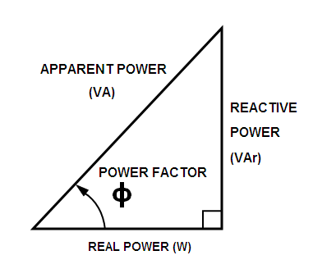
POWER FACTOR
The ratio of the real power flowing to the load, to the apparent power in the circuit.
Apparent power is the product of the RMS current and RMS voltage of the circuit.
A load with a low power factor draws more current than a load with a high power factor for the same amount of useful power transferred. The higher currents increase the energy lost in the distribution system and require larger wires and other equipment.
Power factor = Real Power (KW) /Apparent power (KVA)

Slide 6
BOOST CONVERTER
A boost converter is a DC to DC converter with an output voltage greater than the source voltage.
A boost converter is sometimes called a step-up converter since it "steps up" the source voltage. Since power ( P =VI ) must be conserved, the output current is lower than the source current.
It is a class of switched-mode power supply (SMPS) containing at least two semiconductors and at least one energy storage element: a capacitor, inductor, or the two in combination.
To reduce voltage ripple, filters like DC link capacitors connected across the load side.
The key principle that drives the boost converter is the tendency of an inductor to resist changes in current by either increasing or decreasing the energy stored in the inductor magnetic field.

Slide 7
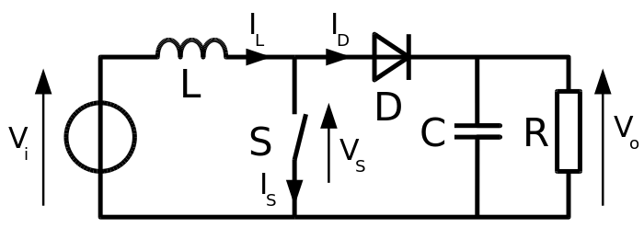
When the switch is closed (on-state), current flows through the inductor in the clockwise direction and the inductor stores some energy by generating a magnetic field. Polarity of the left side of the inductor is positive.
When the switch is opened (off-state), current will be reduced as the impedance is higher. The magnetic field previously created will be reduced in energy to maintain the current towards the load. Thus the polarity will be reversed (meaning the left side of the inductor will become negative). As a result, two sources will be in series causing a higher voltage to charge the capacitor through the diode D.

Slide 8
BLOCK DIAGRAM
PT
DC Power supply for circuit

Slide 9
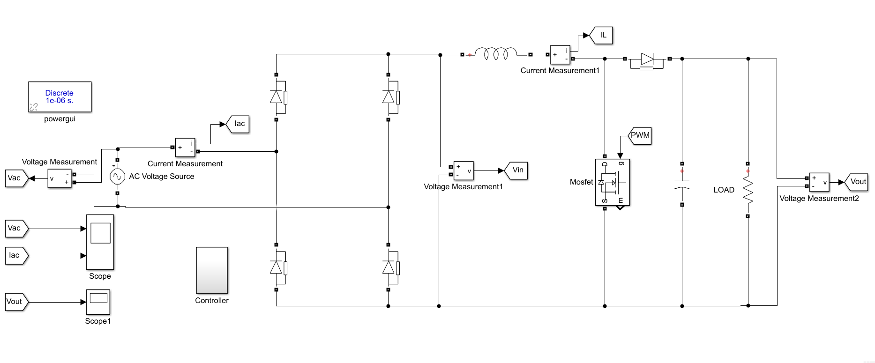
SIMULATION ON APFC CONTROLLER

Slide 10
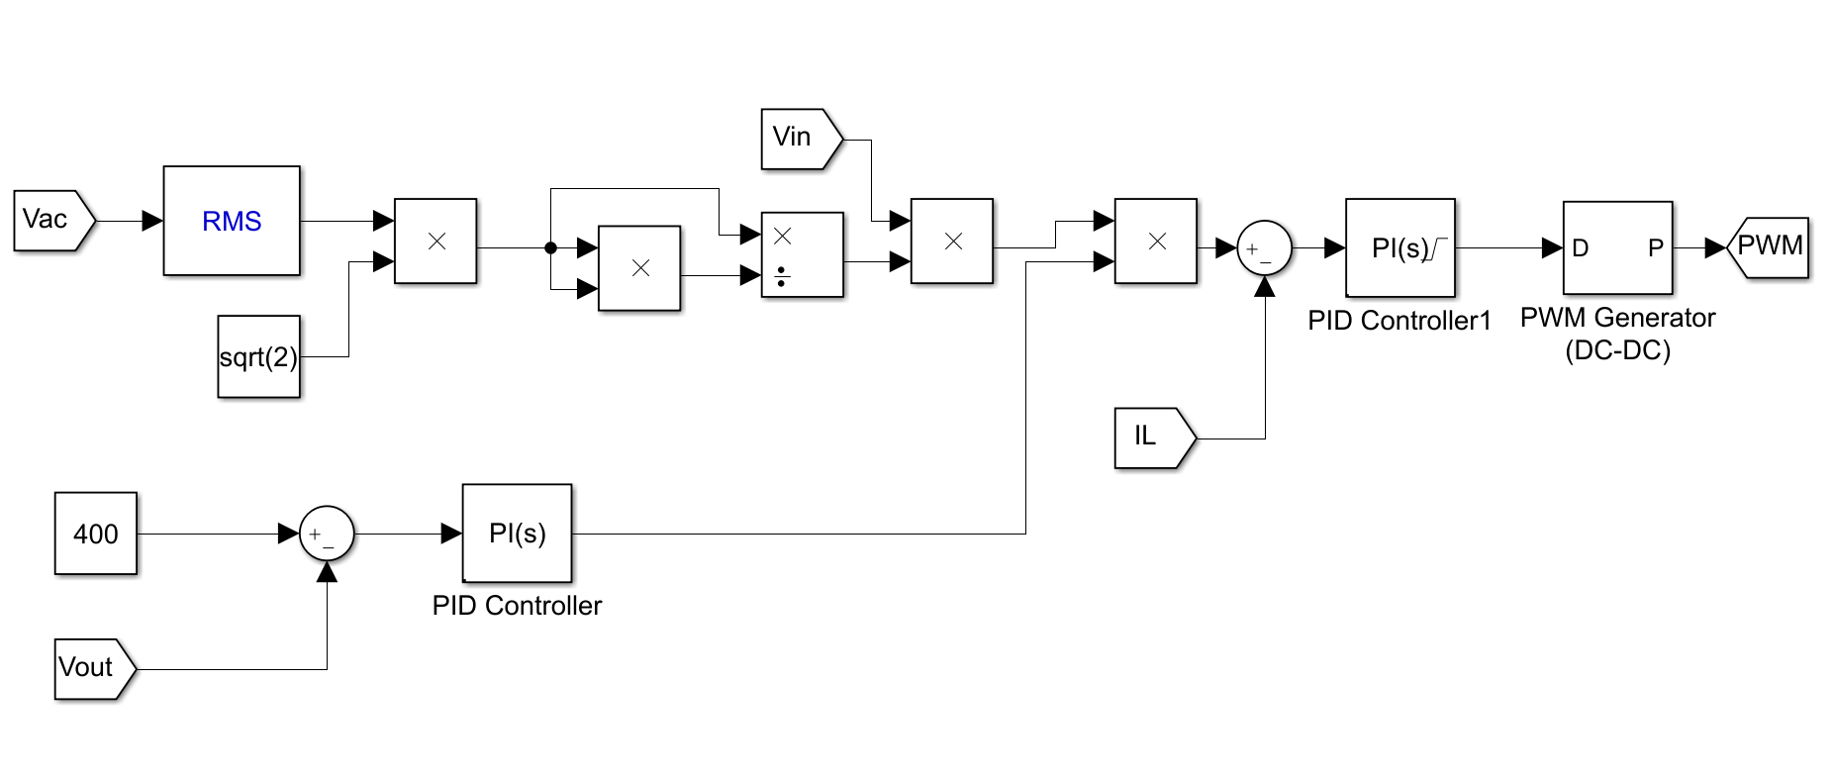
CONTROLLER BLOCK

Slide 11
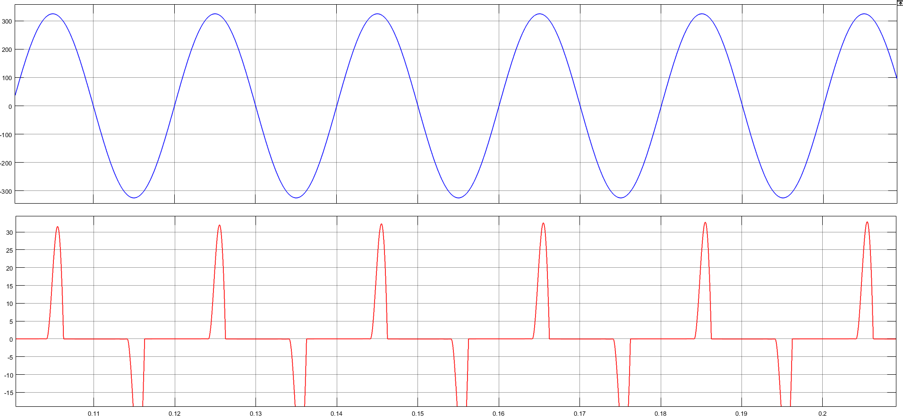
WITHOUT CONTROLLER(NO I/P GATE PULSE)

Slide 12
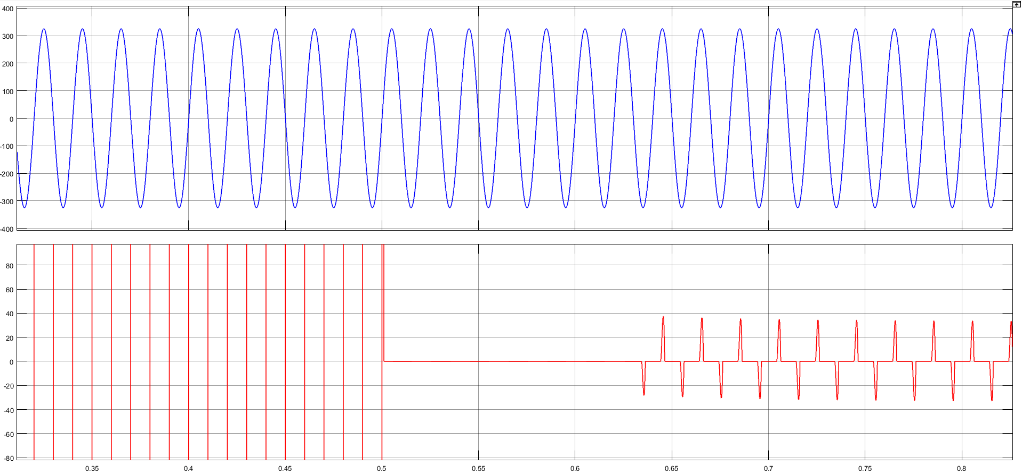
WITHOUT CONTROLLER(I/P GATE PULSE GENERATOR)

Slide 13
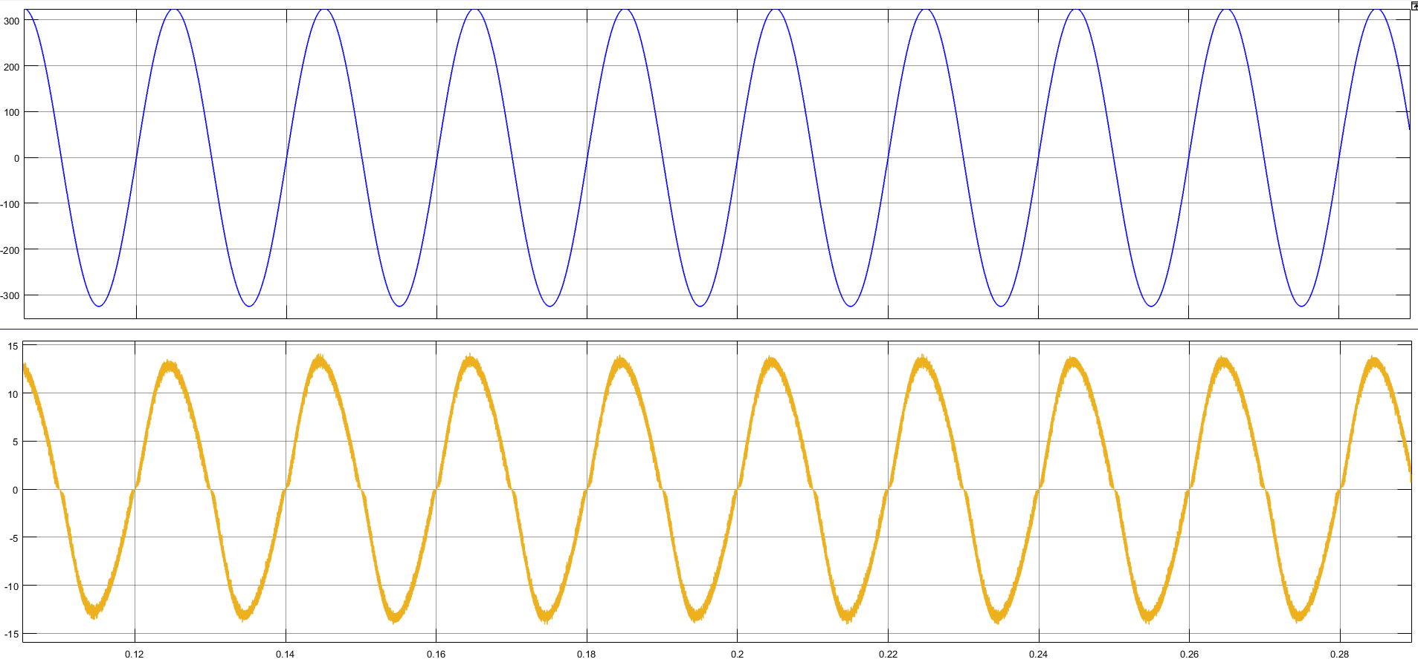
WITH CONTROLLER

Slide 14
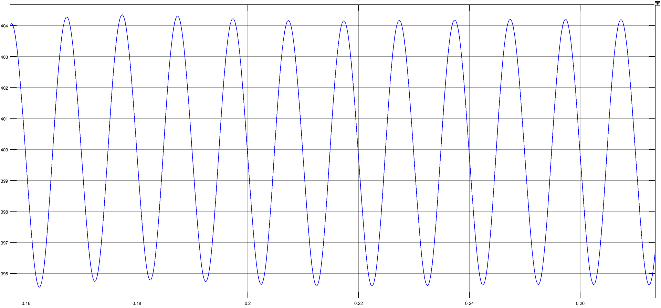
OUTPUT VOLTAGE

Slide 15
REFERENCE
Dheeban SS and Muthu selvan NB ‘2022 International conference for advancement in technology (ICONAT) goa , India ,Jan 21-22 , 2022 .A noval method of power factor correction with reinforced controller under sag and swell condition .
Fredrick De Belie and Khalid javed , 2020 International conference for automation and motion . Feed – Forward control method for digital power factor correction in parallel connected Buck-Boost converter .

Slide 16
Muhammed zashid and Andrew M Knight ,2020 . Local power control by LV distributed Pv for feeder power factor correction and over voltage mitigation .
Panapat Thananukull and Yuttama kamsuwam , 2021. Active power filter in linear system for power factor correction .
Parvez Ahmmed , Shammya shananda saha ,(2013) . Modelling and simulation of a microcontroller based power factor correction .

Slide 17
CONCLUSION
The proposed idea is to design, develop of series active filter with control scheme. The series active filter can perform better in reduction of voltage. The simulation results shows the very good performance of the proposed algorithm.And it was tested under balanced source supplying to non linear load and also unbalanced source supplying non linear load .

Slide 18
Thank you

